Slide 1
Functions
CSE-103: Discrete Mathematics

Slide 2
Functions
Let A and B be nonempty sets.
A function f from A to B is an assignment of exactly one element of B to each element of A. We write f(a) = b if b is the unique element of B assigned by the function f to the element a in A. If f is a function from A to B, we write f : A → B.
Functions are sometimes called mappings or transformations.
‹#›

Slide 3
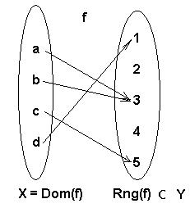
Functions
A function f from a set X to a set Y is a relation from X to Y such that x ∈ X is related to one and only one y ∈ Y
X is called the domain & Y is called the range. We say x is mapped into y.
f = {(a, 3), (b, 3), (c, 5), (d, 1)}

Slide 4
Example
A = {Mike, Mario, Kim, Joe, Jill}
B = {John Smith, Edward Jones, Richard Boone}
Let f:A → B where f(a) means father of a.
f
Mike Mario Kim
Joe Jill
John Smith
Edward Jones
Richard Boone
A
B
Can grandmother of a be a function ?
‹#›

Slide 5
Functions as Ordered Pairs
A function f :A→B can be represented as a set of ordered pairs (recall, a relation)
{(a,b) | a ∈A ∧ b = f(a)} ⊆ A x B
For every a ∈A, there is exactly one pair (a,f(a)).
‹#›

Slide 6
Graphical Representation
A
B
(a,f(a))
B
•
•
•
•
•
•
•
•
•
A
‹#›

Slide 7
Function Terminology
Given a function f:A→B
A is the domain of f.
B is the codomain of f.
If f(a)=b then b is the image of a under f.
a is the pre-image of b under f.
In general, b may have more than 1 pre-image.
The range R of f (or image of f) is :
R = {b | ∃a f(a)=b }. The set of all images of a’s.
For any set S ⊆ A, the image of S,
f(S) = { b ∈ B | ∃a ∈ S, f(a) = b}
For any set T ⊆ B, the inverse image of T
f⁻¹(T) = { a ∈ A | f(a) ∈ T }
‹#›

Slide 8
Function description
Functions are described as:
Set of ordered pairs, example f as given before
Using a formula such as f(x) = expression, example: f (x) = 2x + 2
Illustration as in the example below
‹#›

Slide 9
Cartesian graphs of relations & Functions
Discovering properties of relations and functions from graphs
Example:
x
y
This is a relation but not a function vertical line crosses the graph in two points
‹#›

Slide 10
Example on Function Terminology
Example: Let R be the relation consist of ordered pair (Abdul, 22), (Brenda, 24), (Carla, 21), (Desire, 22), (Eddie, 24) and (Falicia, 22); where each pair consist of a student and the age of that particular student. What is the function that relation determines?
Solution:
The determines the unction f where f(Abdul) = 22, f(Brenda) = 24 and f(Carla) = 21, f(Desire)=22, f(Eddile)=24, f(Falicia)=22.
The domain of the function is the set {Abdul, Brenda, Carla, Desire, Eddie, Falicia}
A codomain needs to specify for the function; which is a set of all positive integers to make sure that the codomain consist of all ages ofstudents, finally the range is {21, 22, 24}
Example: Let A = {a, b, c, d, e} and B = {1, 2, 3, 4} with f(a) = 2, f(b)=1, f(c)=4, f(d)=1 and f(e)=1. What is the image of subset S = {b, c, d}?
Solution:
the image of subset S = {b, c, d} is the set f(s) = {1, 4}
‹#›

Slide 11
Multiple functions on a single range
If f₁ and f₂ are functions from A to R. Then f₁ + f₂ and f₁ f₂ are also functions from A to R defined by
(f₁ + f₂)(x) = f₁(x) + f₂(x)
(f₁ f₂)(x) = f₁(x)f₂(x)
Example: Let f₁ and f₂ be the functions from R to R such that f₁(x) = x² and f₂(x) = x - x². What are the functions of f₁ + f₂ and f₁ f₂?
Solution:
(f₁ + f₂)(x) = f₁(x) + f₂(x) = x² + x - x² = x
and
(f₁ f₂)(x) = f₁(x)f₂(x) = x² (x - x²) = x³ – x⁴
‹#›

Slide 12
Properties of functions
A function is called one to one or (injection) if different elements in the domain are related to different elements in the range.
(f(a)=f(b)) →a = b for all a and b in the domain of f.
a
b
c
d
e
1
2
3
4
5
6
7
‹#›

Slide 13
Properties of functions
A function is called onto or a surjection if each element of the range is related to at least one element in the domain.
For every elements b ϵ B, there is an element a ϵ A with f(a) = b.
a
b
c
d
e
f
1
2
3
4
5
‹#›

Slide 14
Properties of functions
A function is called one-to-one correspondence or bijection if it is both one to one and onto
For each element in the domain there is one and only one element in the range
Number of elements in the domain equals that in the range
a
b
c
d
e
1
2
3
4
5
‹#›

Slide 15
Example of different types of correspondence
1
2
3
4
a
b
c
d
a
b
c
d
1
2
3
4
a
b
c
d
1
2
3
4
1
2
3
4
1
2
3
a
b
C
a
b
c
Onto, not
One-to-one
Onto and
One-to-one
Neither one-to-one nor Onto
Not a function
One-to-one, not Onto
‹#›

Slide 16
Inverse Function
The inverse function of an one-to-one function f from A to B is the function that assign an element b ϵ B to an element a unique element a ϵ A such that f(a) = b.
Inverse function is denoted as f⁻¹
One-to-one correspondence is also called invertible as we can take inverse of it, others are not invertible.
a
b
c
d
f
1
2
3
4
f⁻⁻¹
a
b
c
d
1
2
3
4
‹#›

Slide 17
Composition of Functions
Let g be the function from A to B and f be the function from B to C. The composition of the functions f and g is denoted by f o g, defined by
f o g(a) = f(g(a))
Example: Let f and g be the functions from the set of integers to the set of integers defined by f(x) = 2x + 3 and g(x) = 3x + 2. What is the composition of g and f?
Solution: f o g (x) = f(g(x)) = f(3x + 2) = 2 (3x + 2) + 3
= 6x + 4 + 3 = 6x + 7
g o f (x) = g(f(x)) = g(2x + 3) = 3(2x + 3) + 2
= 6x + 11
‹#›

Slide 18

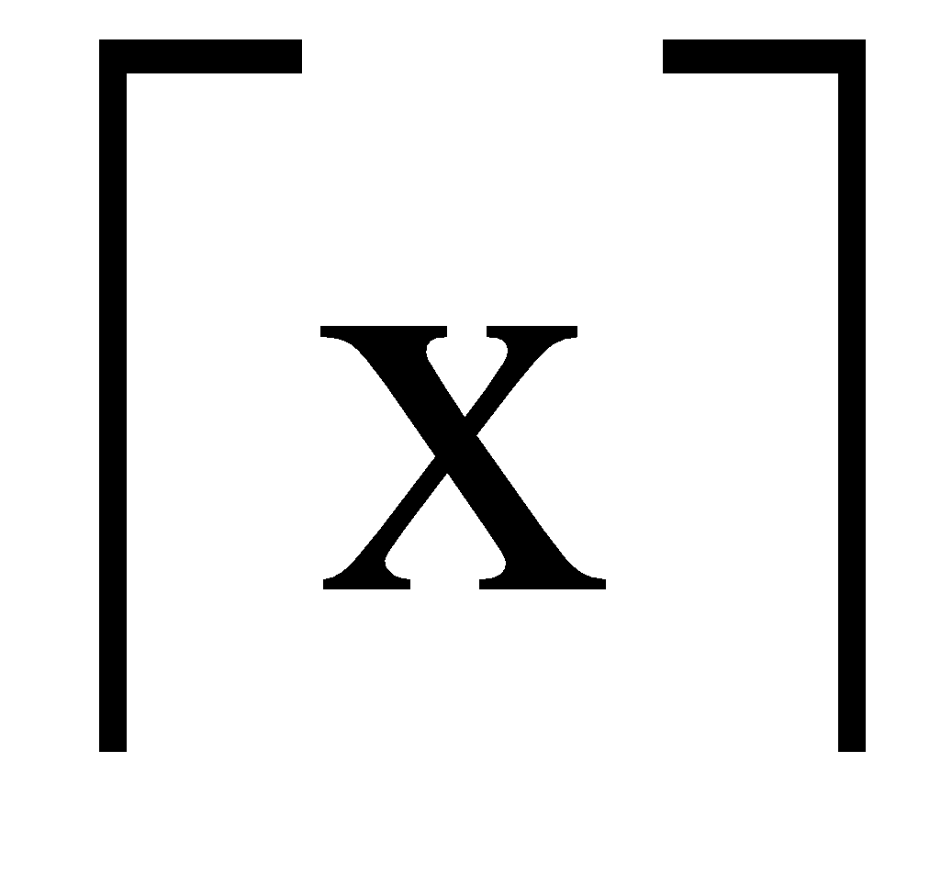
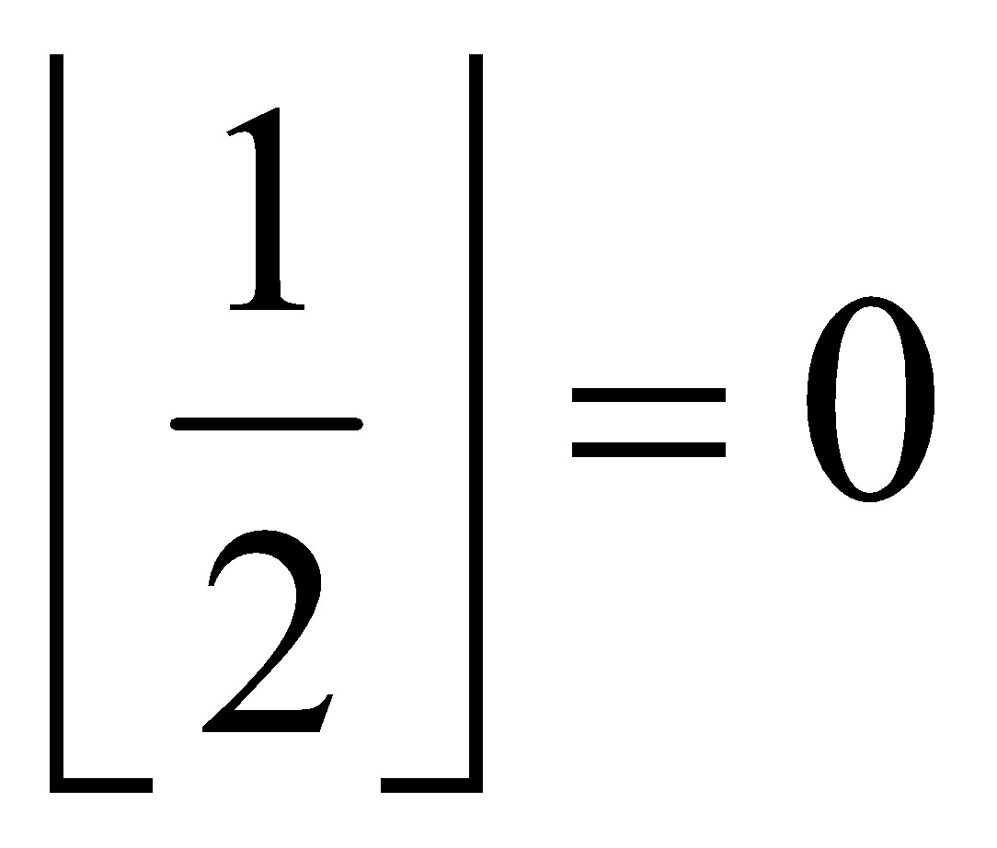
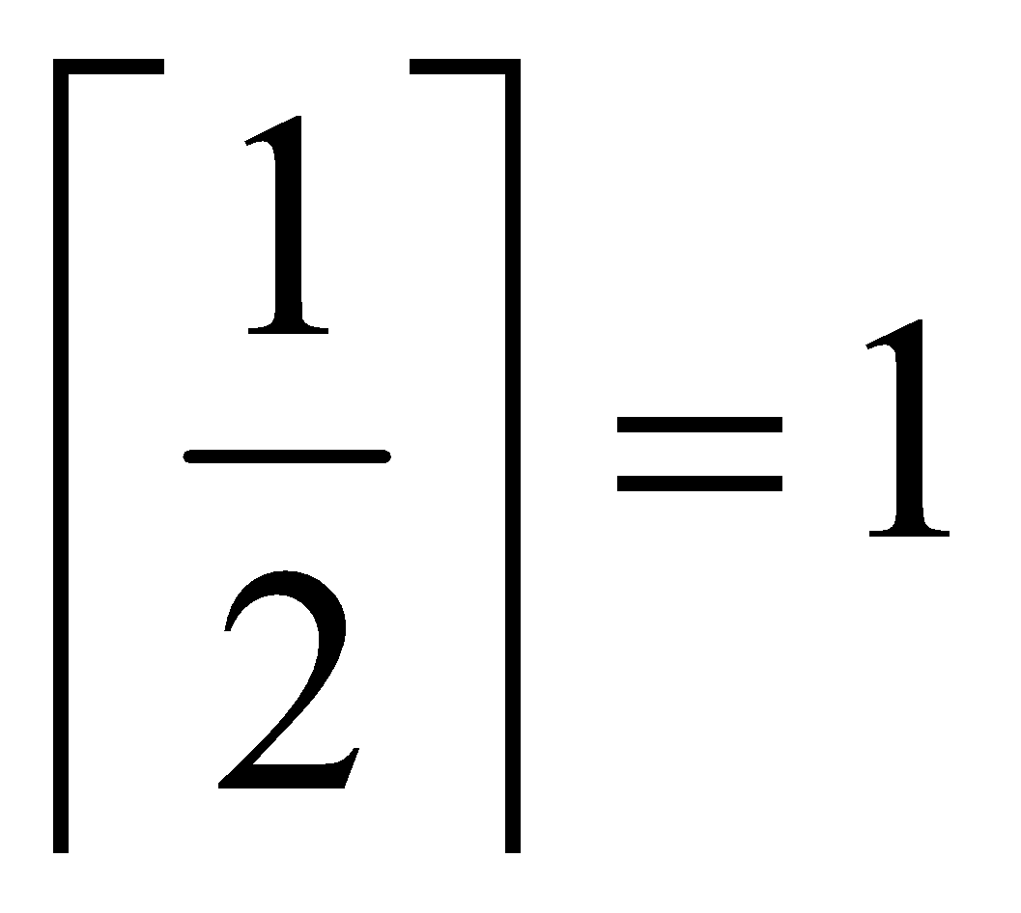
Floor & Ceiling Functions
The floor function to a real number x is the largest integer that is less than or equal to x, denoted as
The ceiling function to a real number x is the smallest integer that is greater than or equal to x, denoted as
Example:
‹#›

Slide 19
Other Functions
In discrete math, we will frequently use the following functions over real numbers:
⎣x⎦ (“floor of x”) is the largest (most positive) integer ≤ x.
⎡x⎤ (“ceiling of x”) is the smallest (most negative) integer ≥ x.

Slide 20
Visualizing Floor & Ceiling
Real numbers “fall to their floor” or “rise to their ceiling.”
Note that if x∉Z, ⎣−x⎦ ≠ − ⎣x⎦ & ⎡−x⎤ ≠ − ⎡x⎤
Note that if x∈Z, ⎣x⎦ = ⎡x⎤ = x.
3
.
2
⎡1.6⎤=2
.
1.6
.
1
⎣1.6⎦=1
0
.
−1
⎡−1.4⎤= −1
.
−1.4
.
−2
.
.
.
⎣−1.4⎦= −2
−3
−3
⎡−3⎤=⎣−3⎦= −3

Slide 21
Plotting floor function
Plot of graph of function f(x) = ⎣x/3⎦:
f(x)
Set of points (x, f(x))
+2
−3
+3
x
−2

Slide 22
Identity function
For any domain X, the identity function I:X→X is the unique function such that ∀a∈X: I(a)=a.
Note that the identity function is both one-to-one and onto (bijective).

Slide 23
Identity Function Illustrations
The identity function:
•
•
•
•
•
•
•
•
•
Domain and range

